Slide 1

CI/CD A Modern Approach to Software Deployment
2018-09-18, by Luís Nabais (https://www.luisnabais.com)

Slide 2

Introduction
Who am I?
Hello! My name is Luís Nabais (https://www.luisnabais.com), I’m a Findmore Consulting employee.
I’m currently working on a Findmore’s client company, called Indra, where I work as a DevOps Engineer.
My specialties are Linux, Docker, Jenkins, DevOps and OpenSource.
I’m a Red Hat Certified Engineer and an ITIL Foundations certified professional.
Agenda
All the content is publicly available (slides, code samples, scripts)
Notes
Feel free to interrupt for questions at any time
Please correct me if you think the pace is too fast or too slow.
Welcome to this Findmore Consulting Workshop! Enjoy!

Slide 3
What will we talk about?
Introduction
Software Deployment
DevOps
Continuous Integration/Delivery/Deployment
Why CI/CD?
How to implement CI/CD
Git
Jenkins
Docker
Challenges
Notas
Git (Gogs, GitLab, GitHub, etc), Jenkins, Docker & Swarm, Kubernetes
DB Deployment
Project
Set Git Repository
Jenkins - Trigger build if there are merge/pull requests in Git Repository
Deploy code to Docker Containers

Slide 4
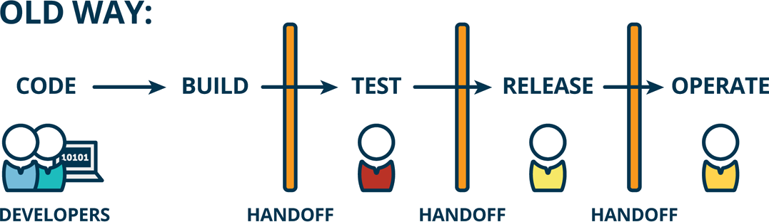
Software Deployment
Software deployment is all of the activities that make a software system available for use.
Build
Test
Release
Operate
Install
Update
Notes:
One person or team for each purpose.
Release - Release Manager / Operate - Operations Team
Management POV: Everyone does only one set of defined functions

Slide 5

Software Deployment
Issues / Conflicts
Each team works on it’s own way, with it’s own methods
Conflicting Priorities
Developer’s job is to create new products, modify existing products and fix defects in the code.
Measured, incentivized and paid based on how often they push code and deliver new value
Operation’s work is based on stability, maximizing predictability and ensuring availability (protect uptime and minimize outages - both which come at risk from change)
Communication between teams is not easy
example: sometimes Developers need debug data of issues which only happen in production, only visible by Operations team.

Slide 6
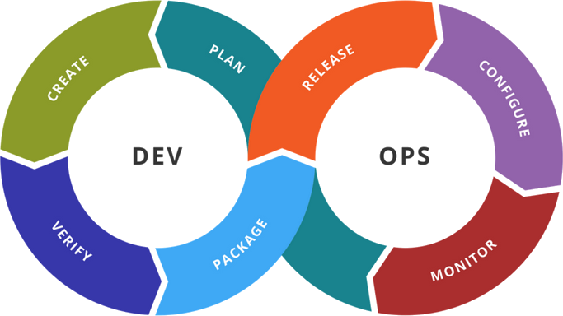
DevOps
DevOps is a culture that promotes collaboration between developers and operations.
Specifically, communication and collaboration during the software delivery and deployment process, with the goal of releasing better quality software more quickly and more reliably.
Common traits of organizations who have a DevOps culture are: autonomous poly-skilled teams, high levels of test and release automation and common goals between the poly-skilled members.

Slide 7
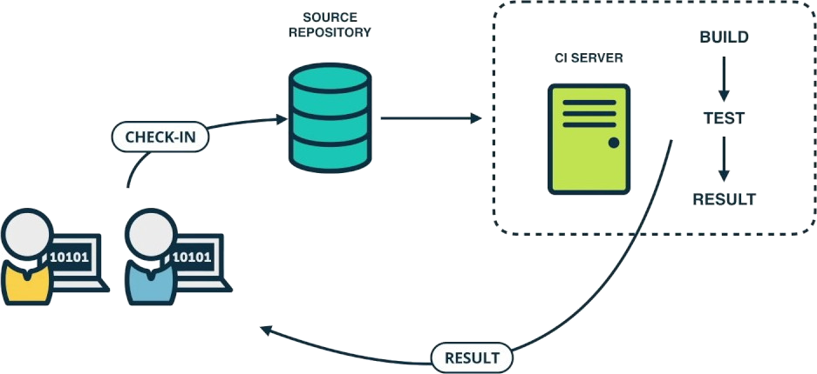
Continuous Integration
Continuous Integration (CI) is a software engineering practice that requires developers to integrate code into a shared repository, several times a day. Each commit/push is then verified by an automatic build, allowing teams to detect problems early.
By integrating regularly, you can detect errors quickly and locate them easily.
Notes:
https://www.atlassian.com/continuous-delivery/ci-vs-ci-vs-cd

Slide 8
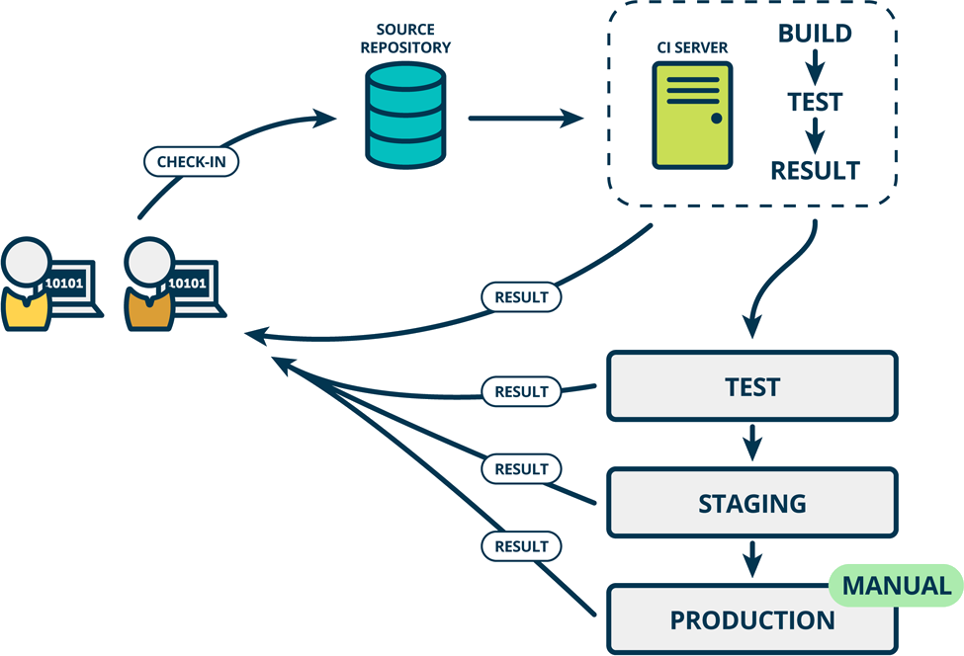
Continuous Delivery
Continuous Delivery (CD) is an extension of Continuous Integration, where software is deployed and tested in production-like environments.
Notes:
https://www.atlassian.com/continuous-delivery/ci-vs-ci-vs-cd

Slide 9
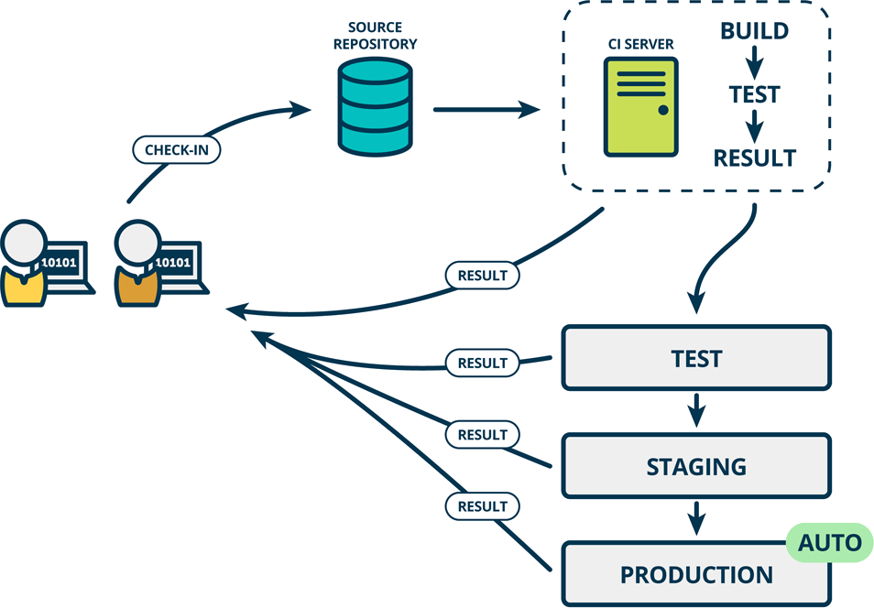
Continuous Deployment
Continuous Deployment (CD) is an extension of Continuous Delivery, where software is deployed automatically in production environment.
Notes:
https://www.atlassian.com/continuous-delivery/ci-vs-ci-vs-cd

Slide 10
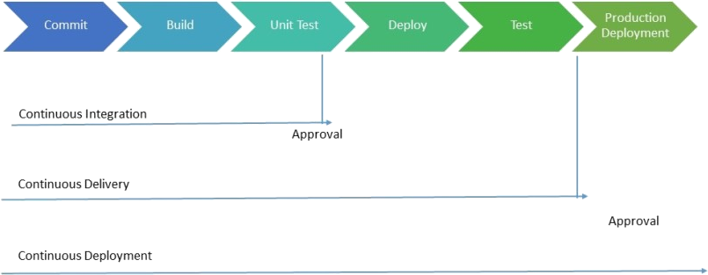
Continuous Integration/Delivery/Deployment
Which one to use? There is no single rule to define which one is better. It purely depends on each company’s needs, on the way software is built, who controls the deployments, among many other factors.

Slide 11


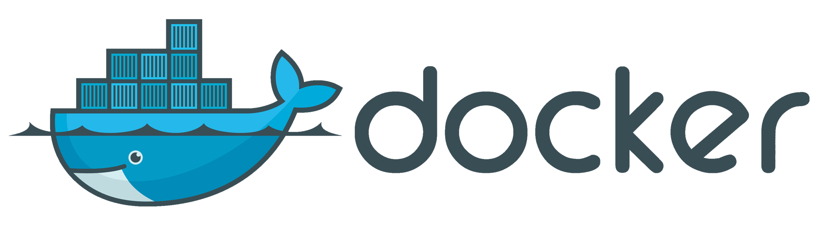





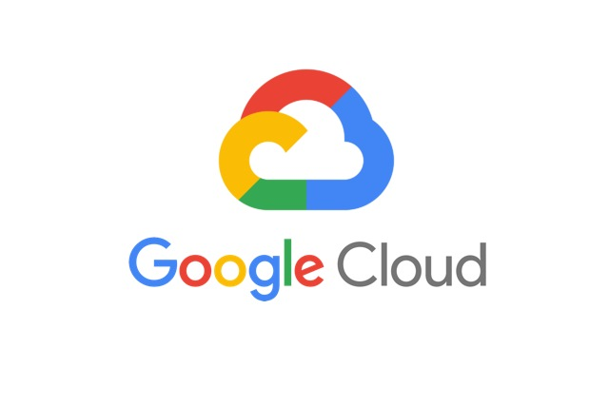

Tools for CI/CD
Code & Versioning Repository - A centralized repository where the developers commit their code to.
Automation / CI Server - A Server which automates processes, based on triggers, and uses other tools to build, test and deploy the applications.
Software Distribution - A platform which allows software to be deployed & scaled automatically.
These tools can be cloud hosted or self hosted. Both ways have advantages and disadvantages such as pricing, maintenance, hardware requirements, among other elements which must be measured before deciding which solution to use.
Below are some of the most used enterprise tools.
Code Repository | CI Server | Software Distribution

Slide 12
Continuous Integration/Delivery Demo
Git repository
https://gitlab.com/luisnabais_talks/cicd_101_talk.git
Demo
We will demonstrate a full CI/CD Workflow, with the following steps:
Update/upgrade a basic website
Commit code to Git repository
Create a Merge Request on Git
Job to build/test will be called automatically
Upgraded version will be available automatically, after merge is approved.
Tools
GitLab
Jenkins
Docker

Slide 13
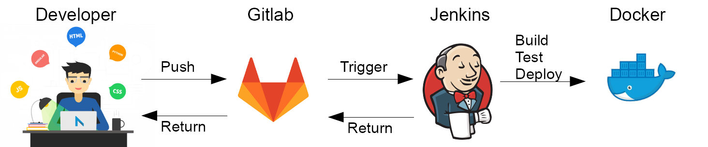
Continuous Integration/Delivery Demo

Slide 14
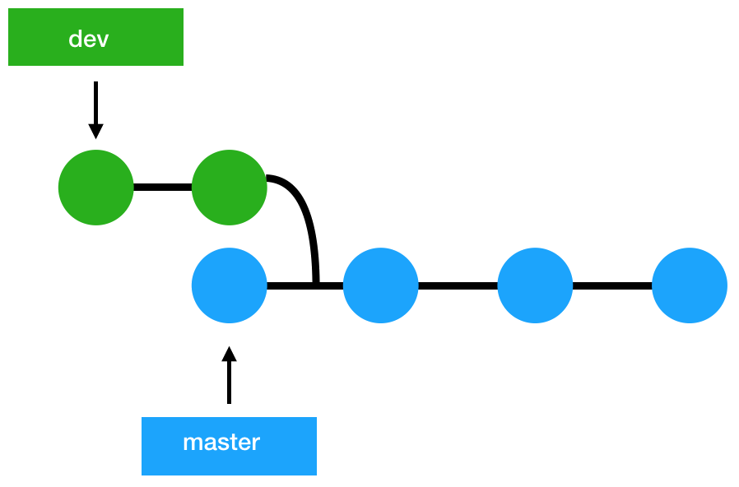
Continuous Integration/Delivery Demo

Slide 15

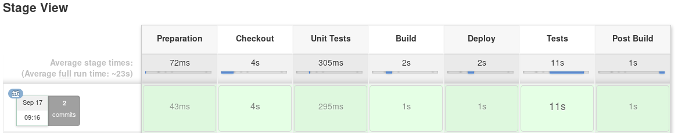
Continuous Integration/Delivery Demo

Slide 16
Challenges / Improvements
Git
Better Git Workflow
Pull/Merge Requests
Branches
Common methods: GitFlow, Forking GitFlow
Microservices
Smaller deployments
Faster testing and deployments
Docker
Incorporate Docker Registry
Others
Incorporate with Slack

Slide 17
Where can I get more information?
About me: https://www.luisnabais.com
Links https://www.atlassian.com/continuous-delivery/ci-vs-ci-vs-cd

Slide 18

Thank you
PS: What do you think about a full workflow deploy workshop?

